Slide 1
Learning via Simulation for Human-Centric Autonomous Systems
Ming C. Lin
lin@cs.unc.edu
http://www.cs.unc.edu/~lin
http://gamma.cs.unc.edu/
Department of Computer Science
University of North Carolina at Chapel Hill
Notes:
Google – Summer 2016
Columbia – Oct. 2016
Chinese NAE DIIT – Oct. 2016 @ Xian

Slide 2

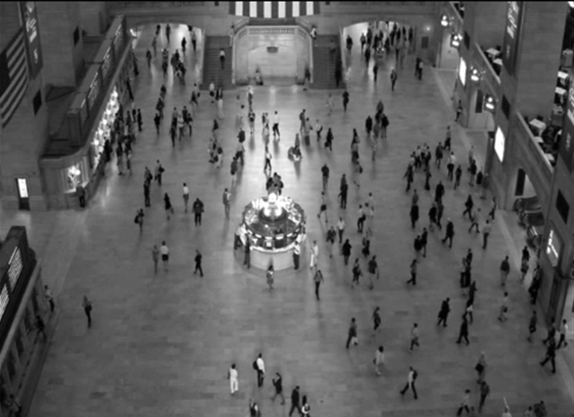
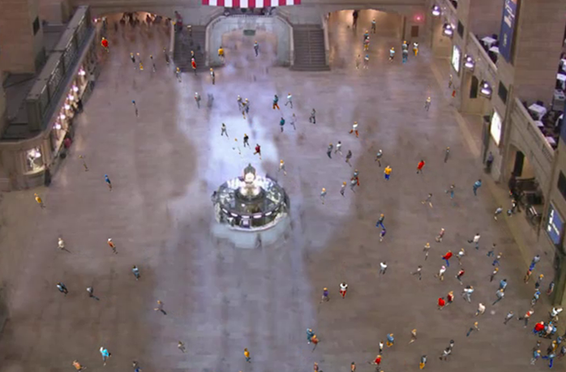


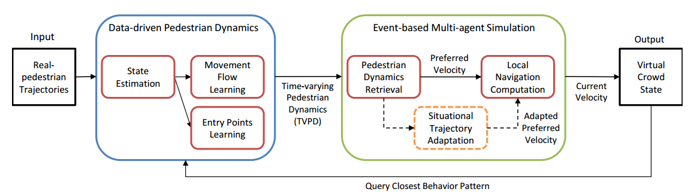
Simulating Crowd Behavior by Learning via Video Example
Data-driven Pedestrian Dynamics
Behavior Adaptation

Slide 3

Example Demo
[Kim et al. IEEE VR 2016]

Slide 4
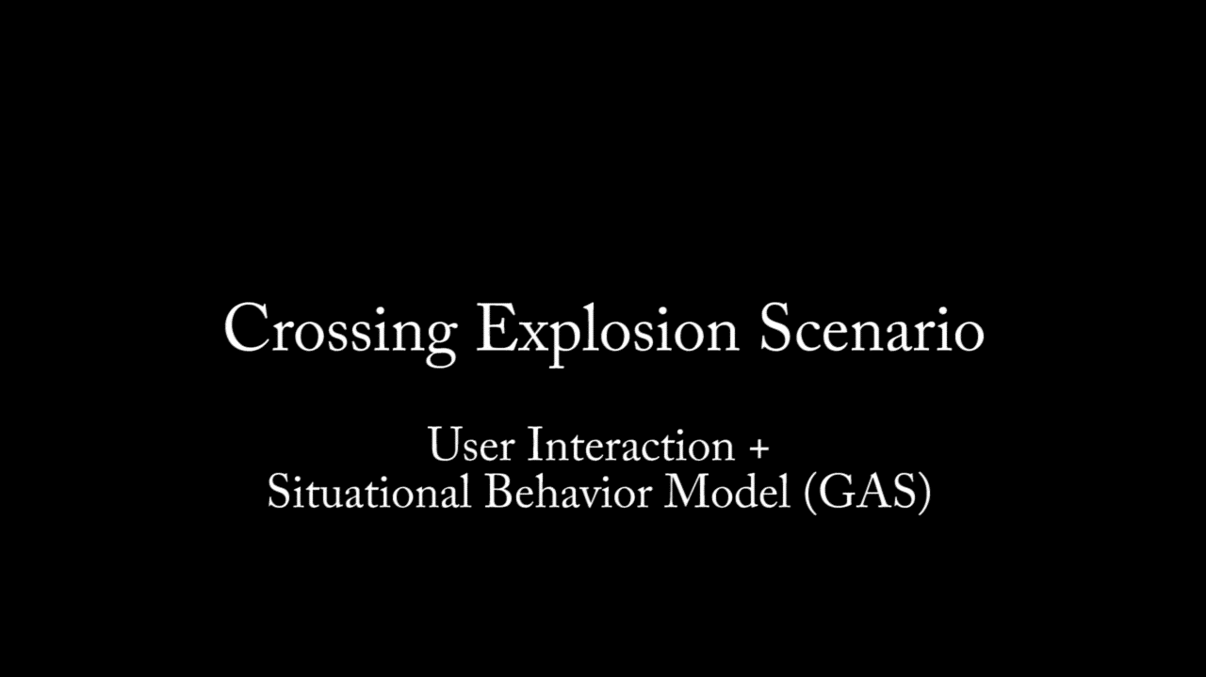
Example Demo
[Kim et al. IEEE VR 2016]

Slide 5
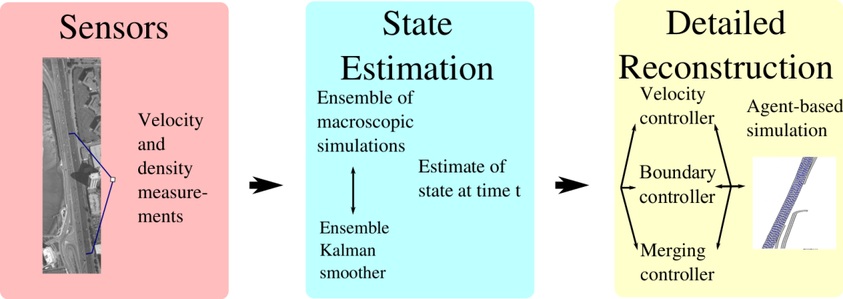
Data-Driven Traffic Simulation
[Wilkie et al; SIGGRAPH 2013]

Slide 6
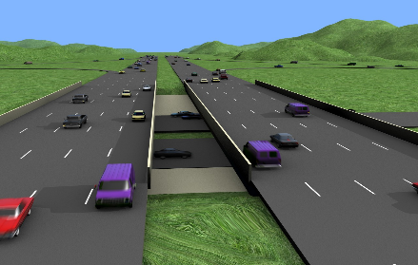
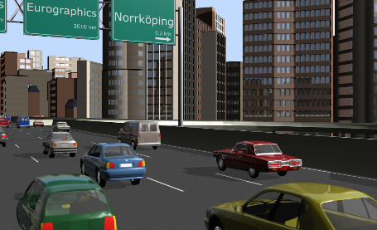
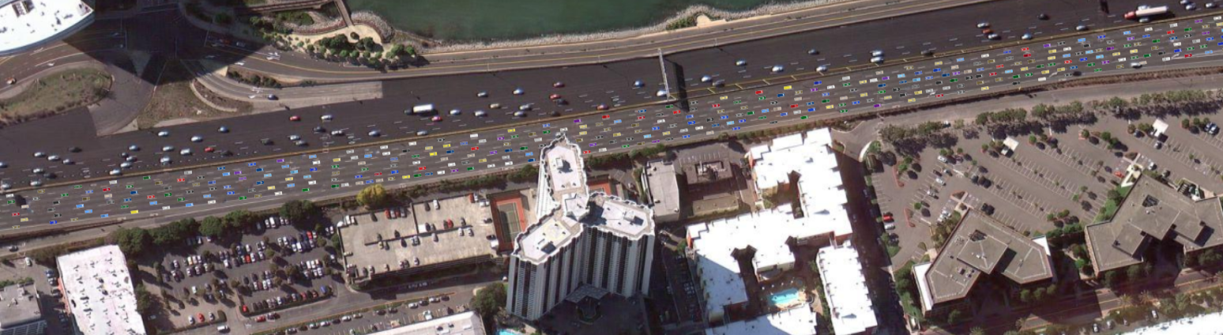
Demo: Traffic Reconstruction from Sensor Data

Slide 7
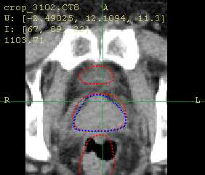
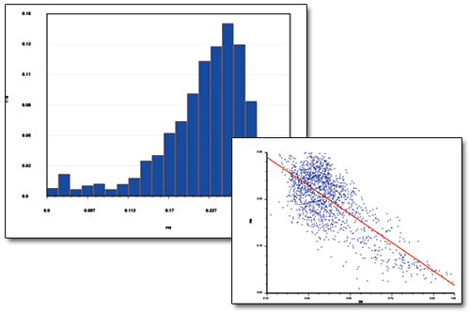
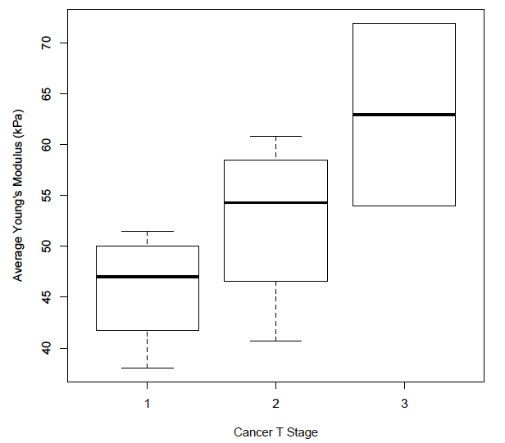
Proactive Health Monitoring Using Patient Specific Tissue Parameters
Medical Images
Cancer
Grades
+ Stages
Tissue Elasticity Estimation
Data Analytics &
Predictive Models
Clinical Classifier
Cancer Prognosis & Treatment
Pre-op Planning & Training
Surgical simulators & robots

Slide 8

Patient-Specific Virtual Surgery and AR Image/Video-Guided Biopsy
[Yang & Lin; IEEE TVCG; CASA2015, ICRA 2016
Yang et al. MICCAI 2016]

Slide 9
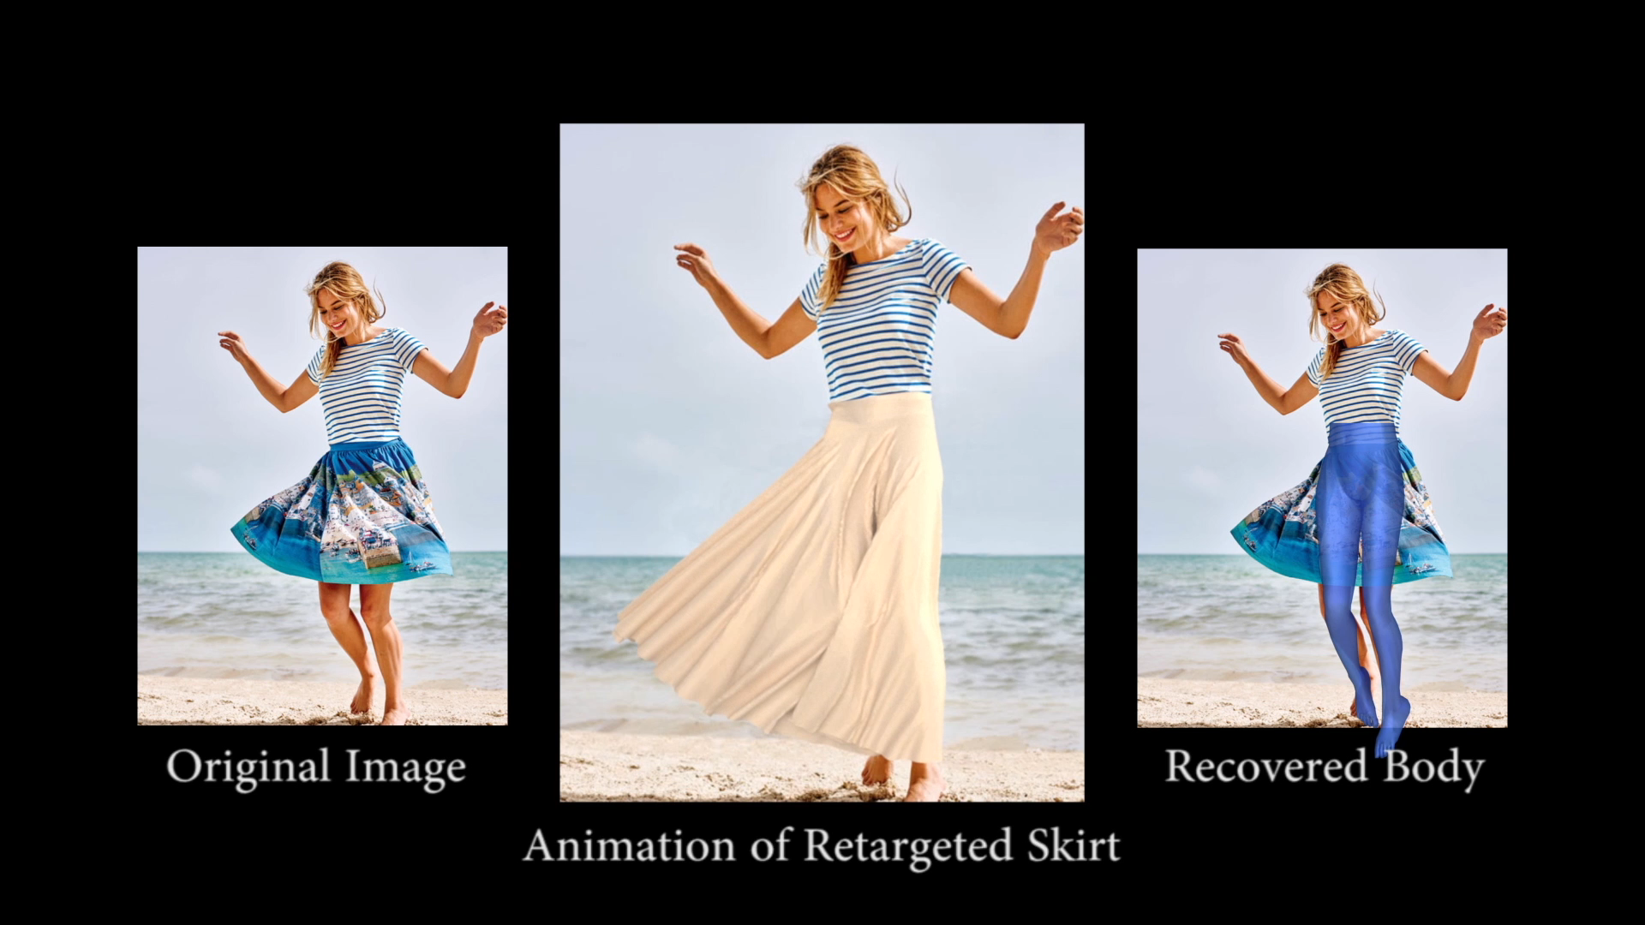
Single-view Image Garment Recovery:
Garment Retargeting

Slide 10
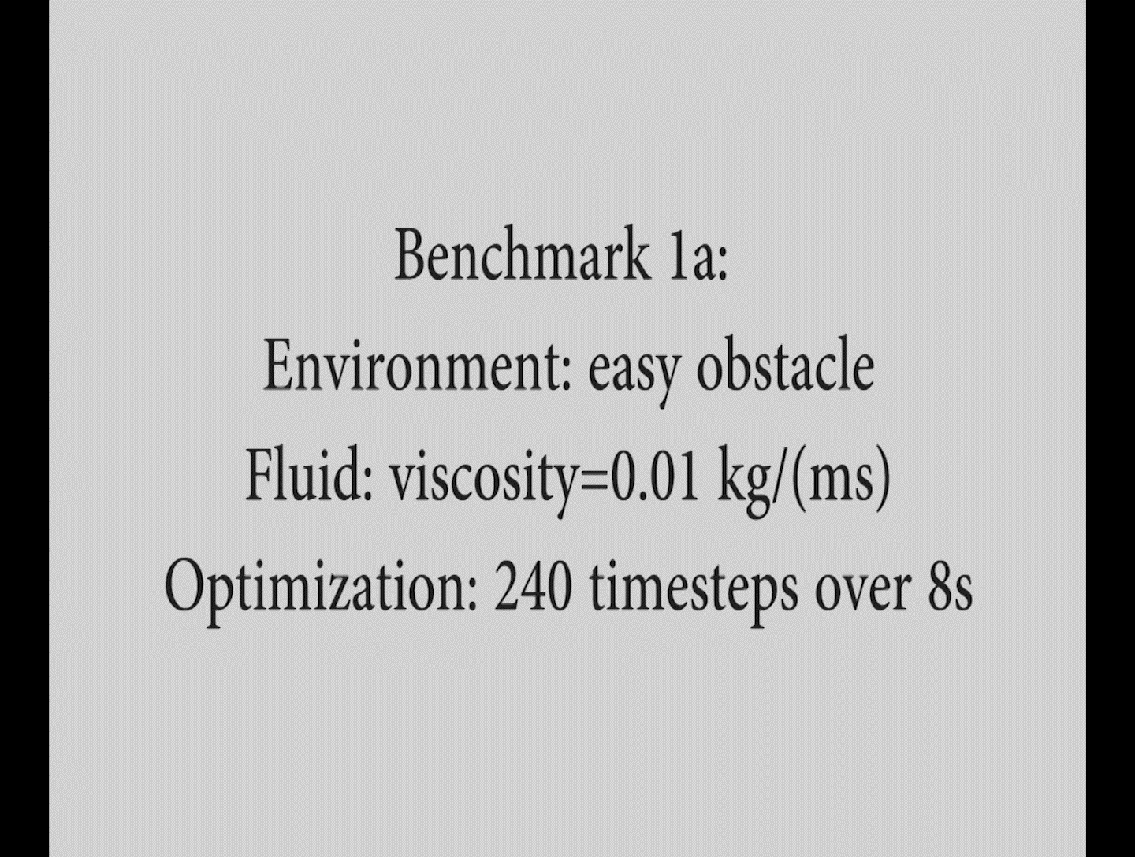

Motion Planning for Liquid Transfer
Motivation
Motion planning for fluid manipulation
Application: moving liquid between containers
Challenge
Expensive liquid simulation in high-dimensional configuration space
Unknown objective function for motion planner
Solution
Learn liquid dynamics using system identification
Learn liquid transfer controller from successful examples
Collect successful examples using stochastic optimization

Slide 11
Grand Challenges
Estimating city traffic dynamics for autonomous vehicles
Predicting pedestrian behaviors for navigation in a dense urban environment for HRI
Avoiding unexpected accidents for autonomous vehicles
Teaching robots to handle fluids
Learning real-world physical parameters through sparse examples for design of robots
e.g. soft robot, medical robots, etc.

Slide 12
Converging of AR, VR, and Autonomy (including Machine Perception)
Capture input/data from physical world to refine, improve, and validate AR/VR systems
Humans interact with data-driven & validated AR/VR system, thereby providing data to further train the human-centric AR/VR systems
Use immersive, adaptive, smart AR/VR systems with human-in-the-loop to capture more cognitive, behavioral and other data for training and designing autonomous systems (e.g. vehicles, surgical systems, etc)
Smart AR/VR systems that adapt and learn are the ultimate human-centric intelligent autonomous systems

